Slide 1
GSD 200 POST ACCEL. ELECTRODE
Maintenance Report
PM TYPE: QPM, YPM / MACHINE: GSD-5
Presented By: SAMUEL - 山姆爾
IMPLANTER-Diffusion Department [S220]

Slide 2
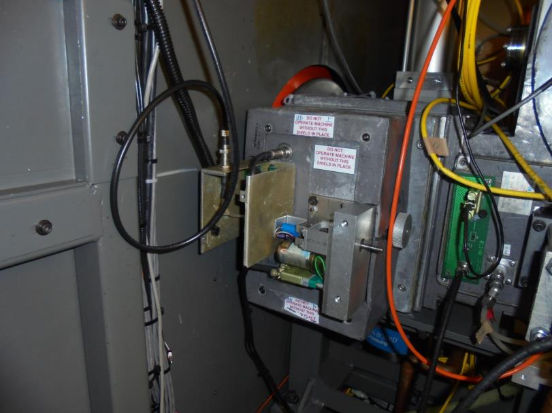

POST ACCEL. ELECTRODE ASSEMBLY

Slide 3
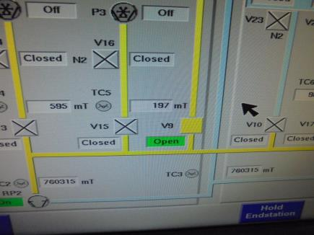

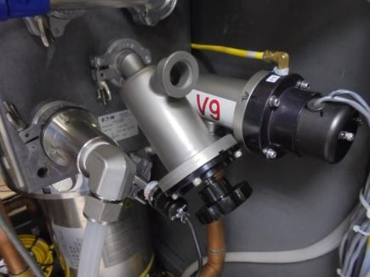

-Close the V9 Valve [BEAMLINE ROUGHING VALVE]
-Open V23, V24 , Vent BEAMLINE CHAMBER
To ATM… [ > 99.9 T ]
Attached Low Vacuum on MANUAL VENT VALVE
To Suction Gas Odor On The Chamber… [OPTIONAL]

Slide 4
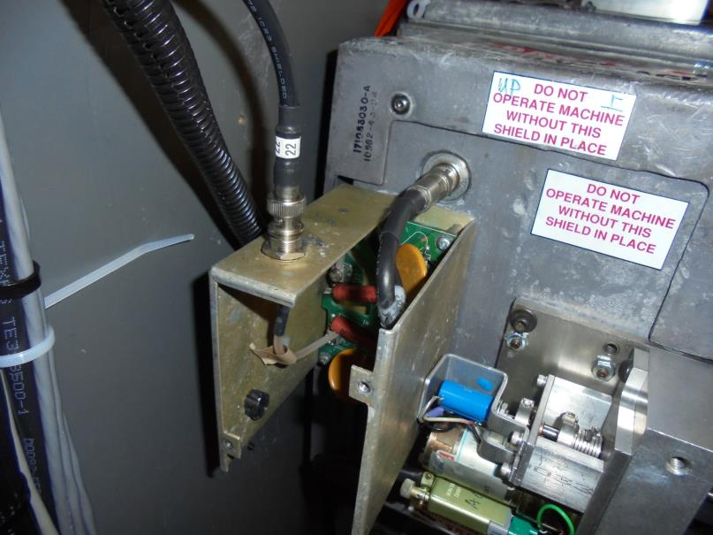

IMPLANTER-Diffusion Department [S220]
Remove SUPPRESSION
2.5KV BNC CABLE

Slide 5
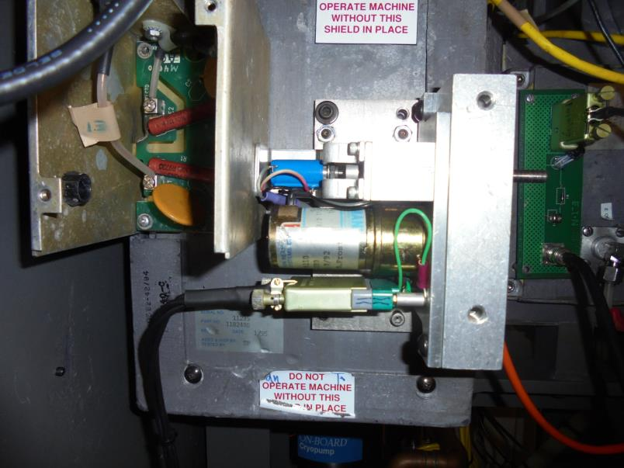
Remove ELECTRODE GAP MOTOR CONNECTOR

Slide 6
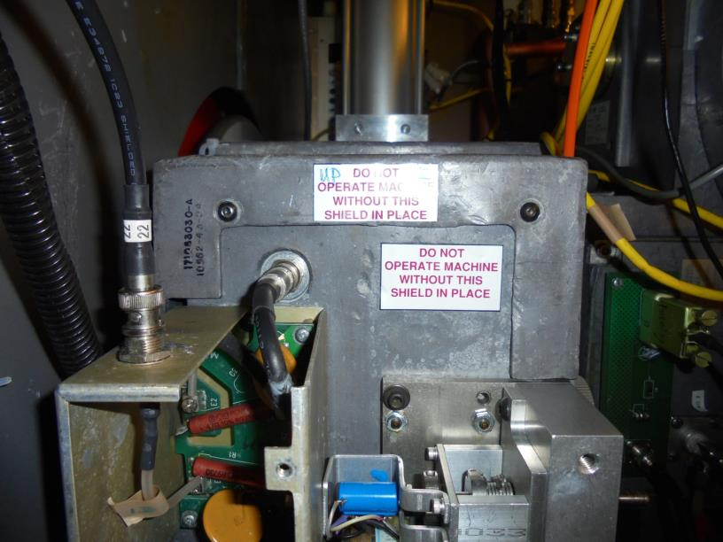

Remove The UPPER ANTI-RADIATION COVER
[2 SCREWS]

Slide 7
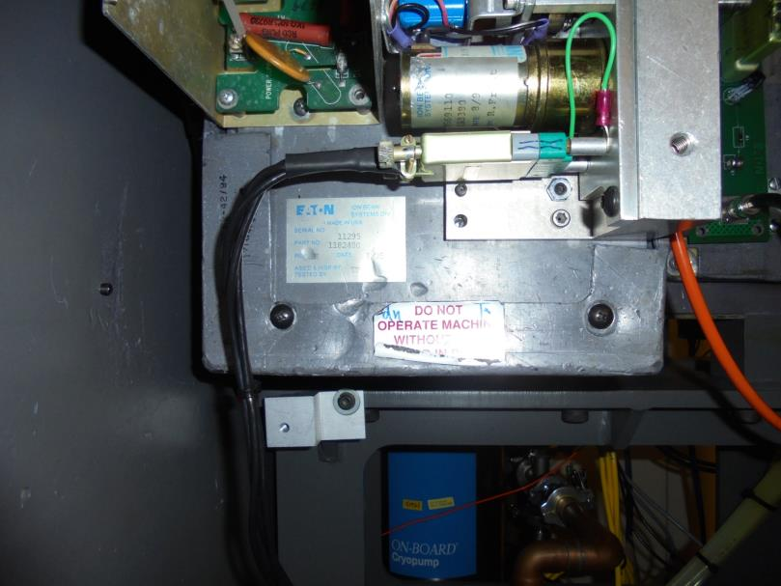

Remove BOTTOM ANTI-RADIATION COVER
[2 SCREW]

Slide 8
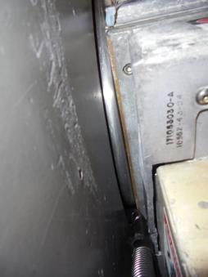
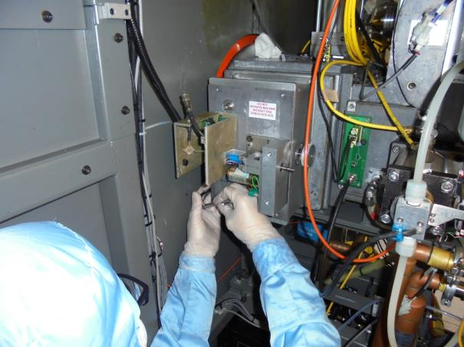

Remove 4 Mounting Screws Of The ASSEMBLY
2 Screws Located On
This Area…

Slide 9
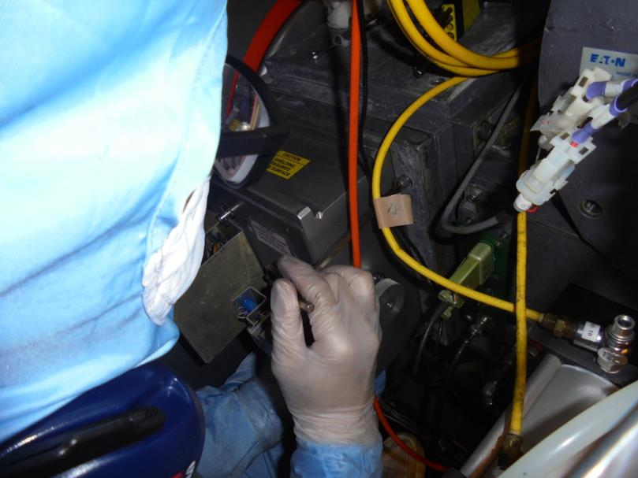

- Other 2 Screws Located On This Area
- Carefully Remove The POST ACCEL. ASSEMBLY

Slide 10
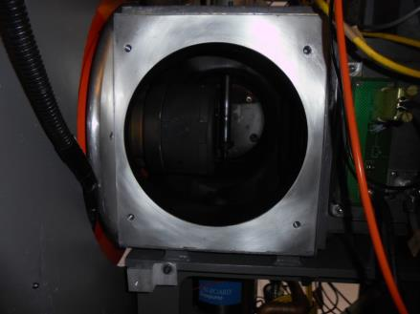
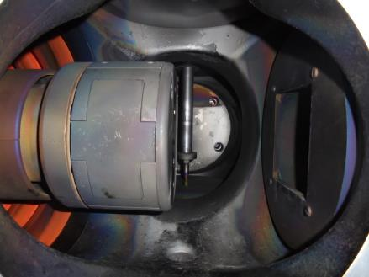

A
B
QUADRUPOLE ASSY.
Mounting Surface
You Can Attached Low Vacuum Here [OPTIONAL]
Inside The Chamber…

Slide 11
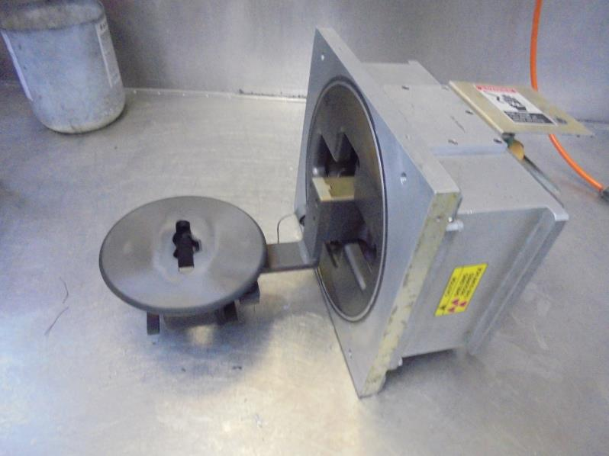
POST ACCEL. ELECTRODE

Slide 12
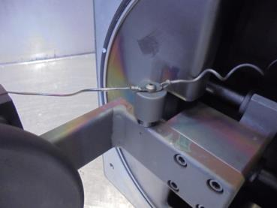
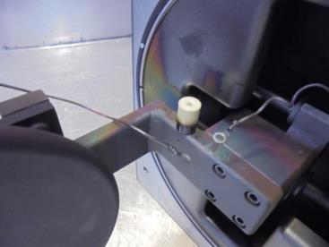
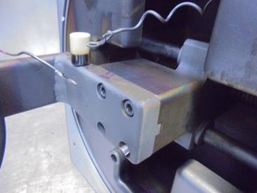
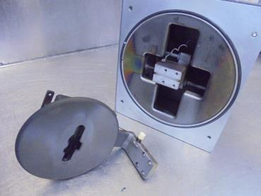
A
B
REMOVE SCREW and INSULATOR COVER
[REPLACE INSULATOR]
C
D
REMOVE 4 SCREWS…
TAKE-OUT THE ELECTRODE…

Slide 13
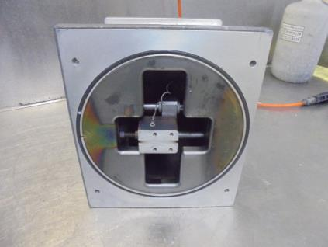
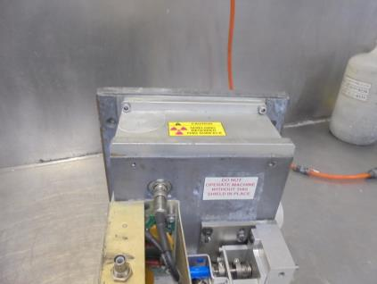
BASE PLATE COVER
REMOVE 4 SCREWS…

Slide 14
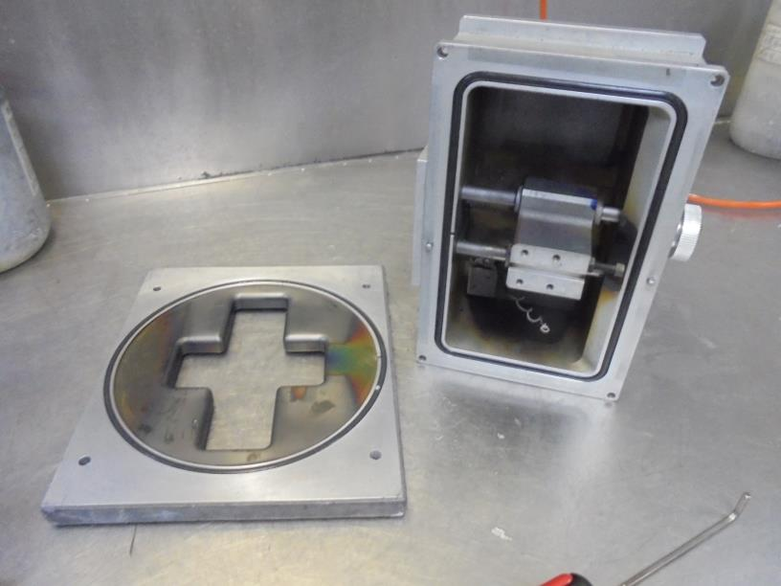
TAKE-OUT THE BASE PLATE

Slide 15
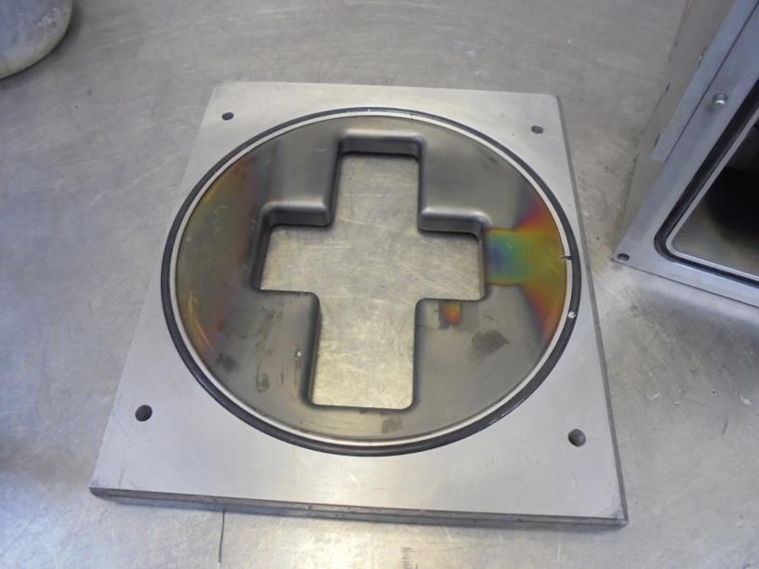
-CHECK / CLEAN O-RING
-CLEAN THE BASE PLATE COATING

Slide 16

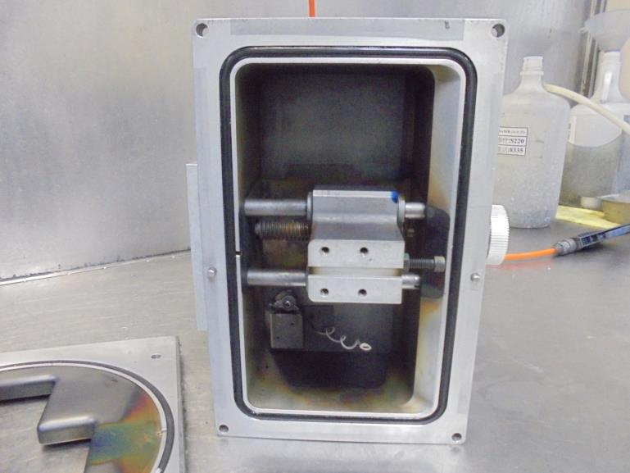
CLEAN INSIDE THE ASSEMBLY
- REMOVE SUPPRESSOR LINE and COVER
- REMOVE O-RING CHECK / CLEAN

Slide 17
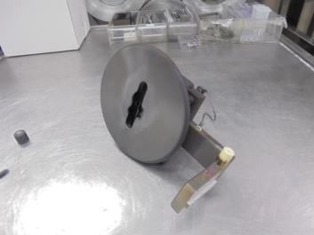
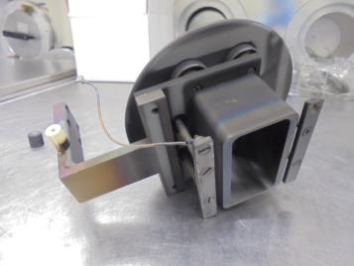


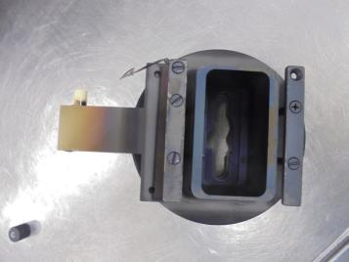
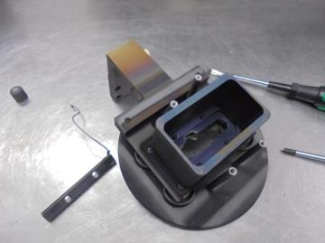
APERTURE [GRAPHITE]
POST ACCEL. APERTURE [GRAPHITE]
POST ACCEL. ELECTRODE [ FRONT ]
[ BACK ]
LOOSEN 4 SCREW…
REMOVE BAR…

Slide 18
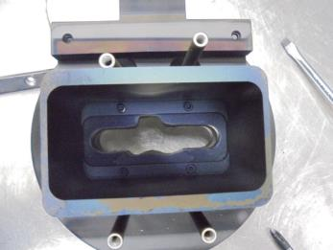
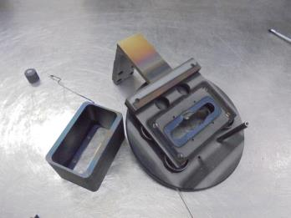


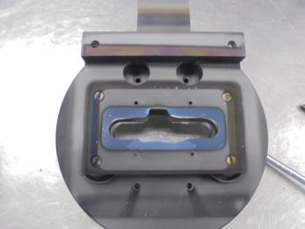
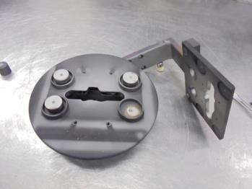
POST ACCEL.
APERTURE
BLOCK
Remove ELECTRODE
STAND-OFF
LOOSEN 4 SCREWS…
REMOVE POST ACCEL. APERTURE BLOCK
Remove INNER and OUTER
Insulator Cap Shield…
LOOSEN 4 SCREWS…
REMOVE ELECTRODE PLATE

Slide 19
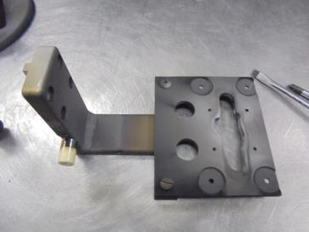
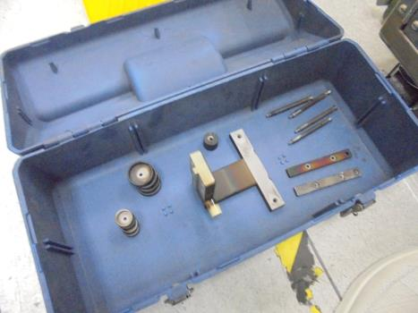
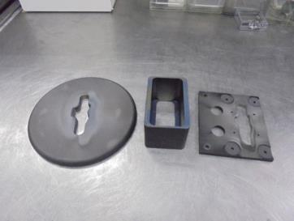
REMOVE GROUND PLATE on HOLDER
APERTURE
GROUND PLATE
COMPONENTS FOR SAND BLAST CLEANING
POST ACCEL.
APERTURE
BLOCK
FOR DISH SCRUB CLEANING…

Slide 20
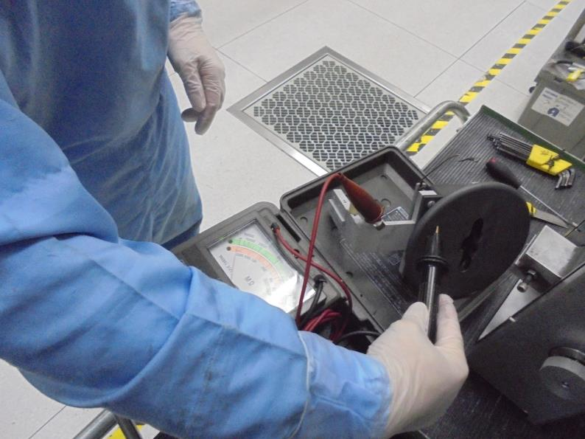
-After Cleaning The Components
Assemble The ELECTRODE…
-Test With HIGH VOLTAGE Meter

Slide 21
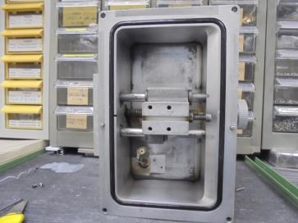
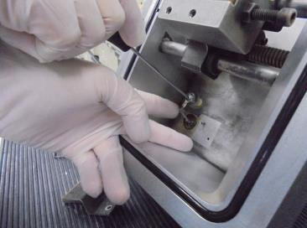
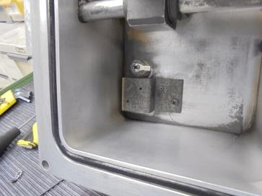
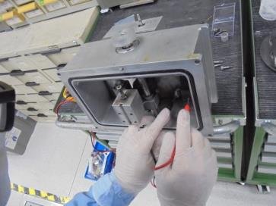
REPLACE INSULATOR…
RE-CONNECT SUPPRESSOR WIRE…
INSTALL THE COVER…
USE DVM…CHECK ISOLATION MUST BE “Over Load”

Slide 22
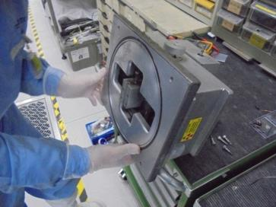
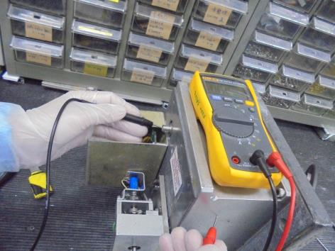
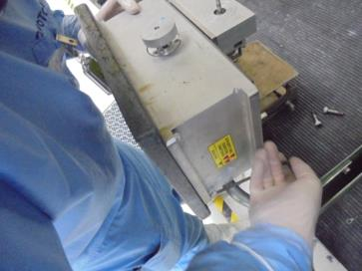
RE-INSTALL THE BASE PLATE…
DVM CHECK SUPPRESSOR to BODY
[ Must Be “Over Load” ]
SECURE TIGHT THE SCREWS…

Slide 23
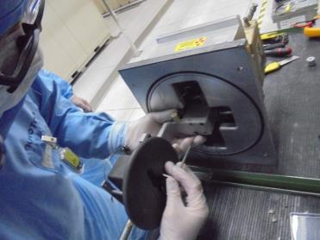
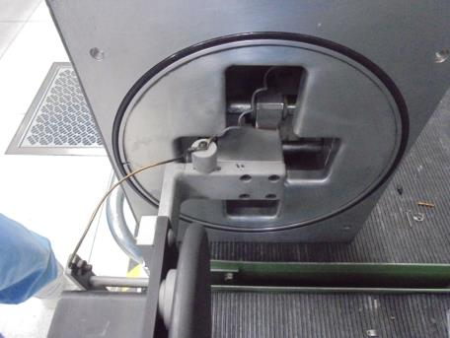
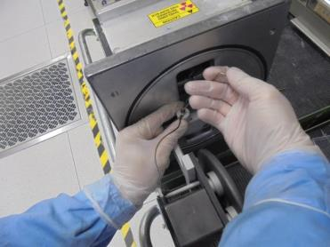
RE-INSTALL ELECTRODE to ASSEMBLY…
TAP CONNECTING
RE-CONNECT ELECTRODE WIRE…

Slide 24
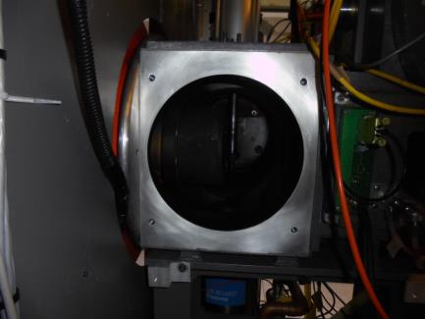
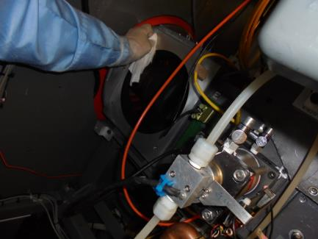
USE LOW VACUUM TO SUCTION
SOME GAS PEEL RESIDUE INSIDE
THE CHAMBER…
CLEAN THE MOUNTING SURFACE
USING IPA BEFORE INSTALLING…

Slide 25
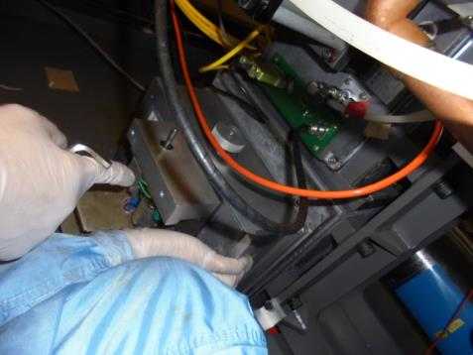
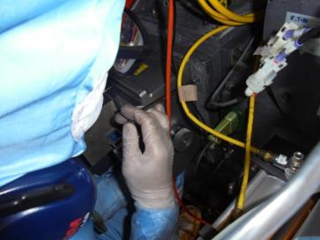
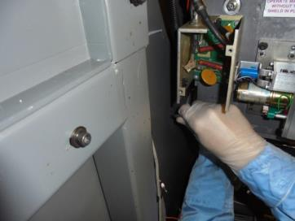
INSTALL…
A
Knee Support the
Weight
CAREFULLY SLID INSIDE THE POST ACCEL. ASSY…
YOU CAN USE YOUR KNEE TO SUPPORT
THE ASSEMBLY WEIGHT SO YOU CAN
EASILY SET and TIGHTEN THE SCREWS.
B
TIGHTEN THE A. UPPER SCREWS
B. BOTTOM SCREWS

Slide 26
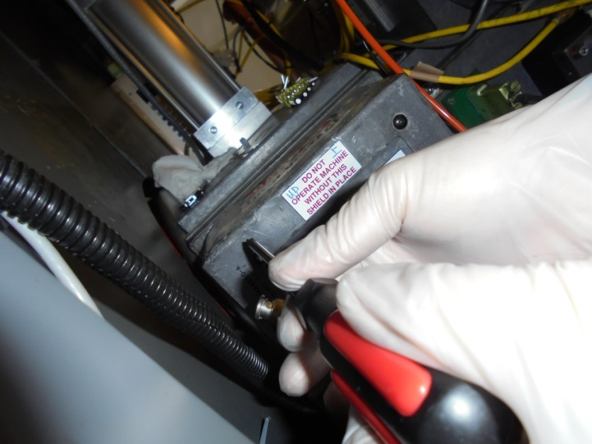



UPPER
BOTTOM
RE-INSTALL THE ANTI-RADIATION COVER
-Pb [LEAD] MATERIAL-

Slide 27




DOUBLE CHECK IF SUPPRESSOR P.S. IS CONNECTED…
DVM CHECK-SUPPRESSOR LINE
POST ACCEL. ASSY.
OK-PASS!

Slide 28



RE-CONNECT ELECTRODE GAP
MOTOR CONNECTOR…
RE-CONNECT SUPPRESSION
2.5KV BNC CABLE

Slide 29




Maintenance Done.

